Slide 1
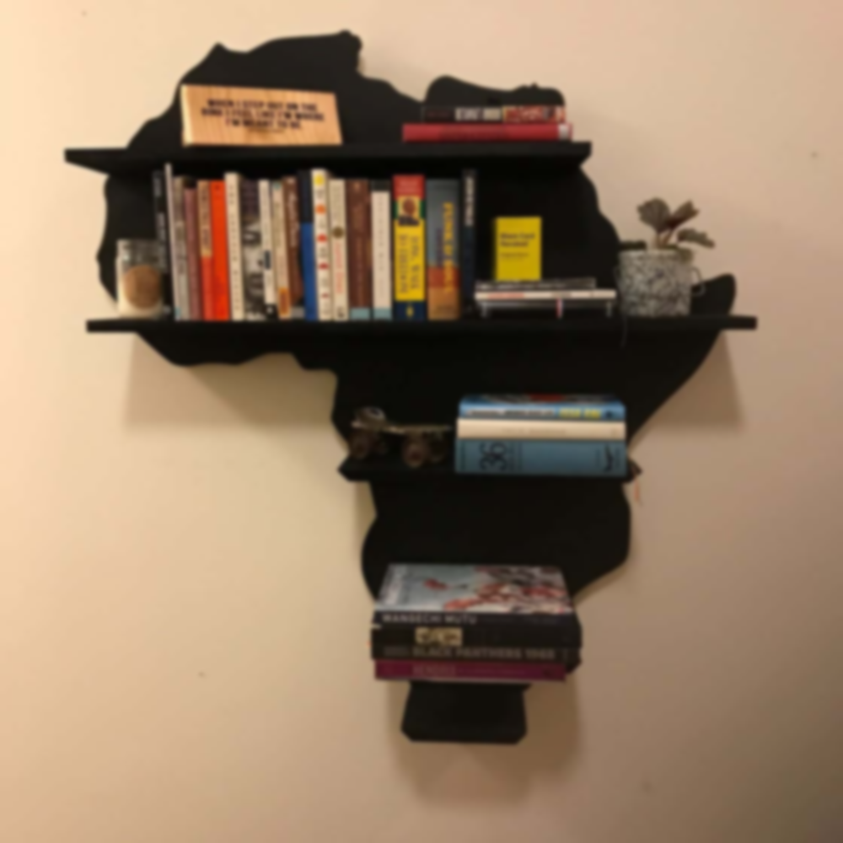
WELCOME TO OUR LIBRARY WEBSITE PRESENTATION
MADE BY:
FEYEM CHRIS
BERNADO NJOGA
ABDUL IDRISS
COORDINATOR:
MR KAMBANG SAINCLAIRE

Slide 2
STEPS
INTRODUCTION
WOKDONE
DEMO
CHALLENGES ENCOUNTERED
CONCLUSION
REMARKS
QUESTIONS
1
2
3
4
5
6
7

Slide 3
WOKDONE
1
2
3
HTML
And
CSS
Which are used for the structure and the styling of a web page
GOOGLE FONTS
Which is a site where you
Have the possibility to have different fonts
Coolors.co
Which is a website which you can use for different colour palettes

Slide 4

3
5

Slide 5

CHALLENGE ENCOUNTERED
1
2
WRITING THE CODE
(modifying sometimes the code crashes )
FINDING DIFFERENT BOOKS

Slide 6
Conclusion and Remarks It was very challenging, interesting and instructive Better is still to come with our future work Thanks to our Coordinator Mr Kambang Sainclaire

Slide 7
QUESTIONS ???

